Slide 1

Post-ENM

Slide 2
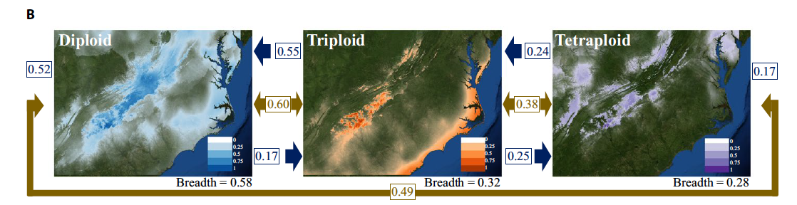
Post-ENM: Niche Breadth
Niche breadth:
is a means of calculating the breadth of suitable climatic factors for a species, providing a value ranging from 0 to 1.
larger values represent more generalist species with wider climatic tolerances
smaller values represent more specialized species with more narrow tolerance

Slide 3
Post-ENM: Niche Overlap
Niche overlap (gold):
Schoener’s D ranges from 0 to 1
0 represents no niche similarity between the models
1 represents completely identical niches
Geographic Overlap (blue):
percentage of points found in the models A distribution relative to those in the model Bs distribution.

Slide 4
Post-ENM: Geographic Overlap
Geographic Overlap (blue):
percentage of points found in the models A distribution relative to those in the model Bs distribution.

Slide 5
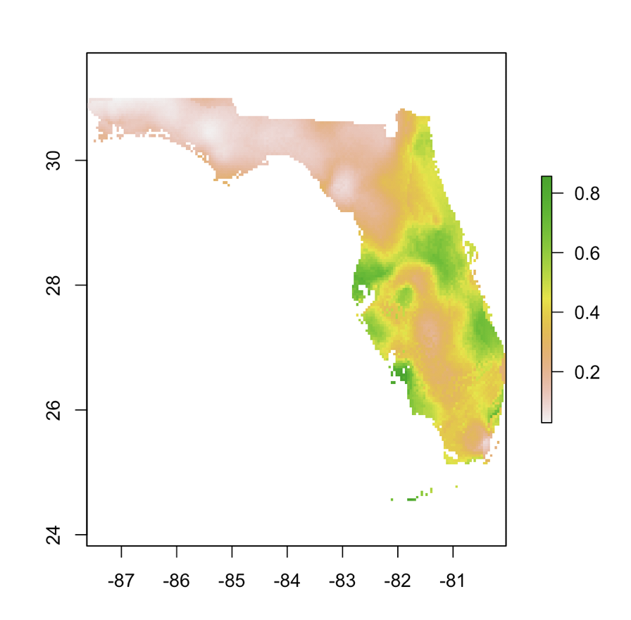
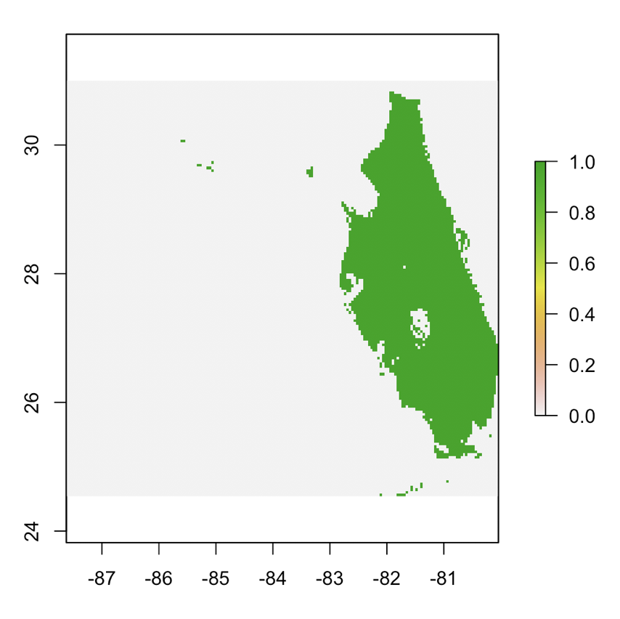
Post-ENM
Geographic Overlap
Reclassify

Slide 6
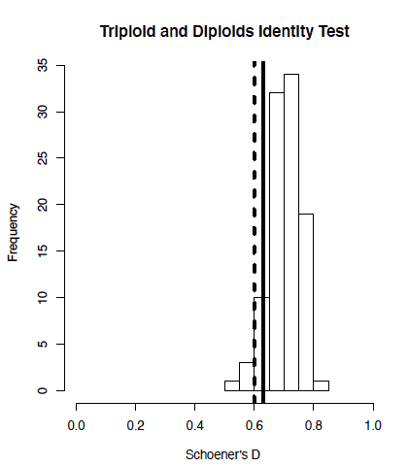
Post-ENM: Niche Identity and Background Test
Niche Identity Test:
Is niche overlap more different than expected if drawn from the same underlying distribution?
Comparing niche models with the same number of occurrence records as the original models, but with randomly distributed localities x 100
Niche Background Test:
Is niche overlap more similar than expected by chance based on the geographical regions they reside?
Warren et al. 2010. ENMTools: a toolbox for comparative studies of environmental niche models

Slide 7
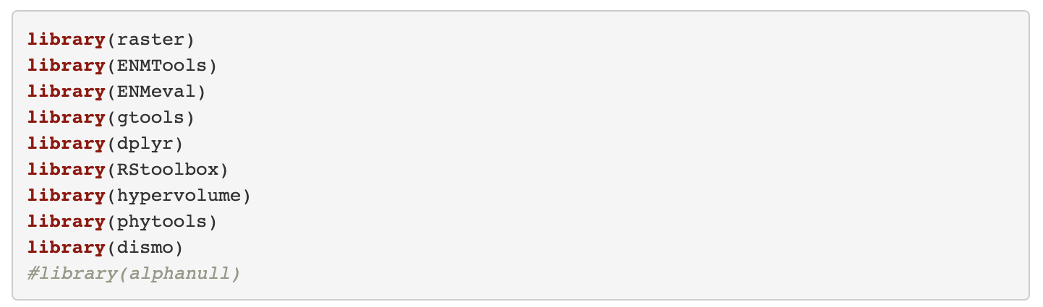
Load Packages

Slide 8
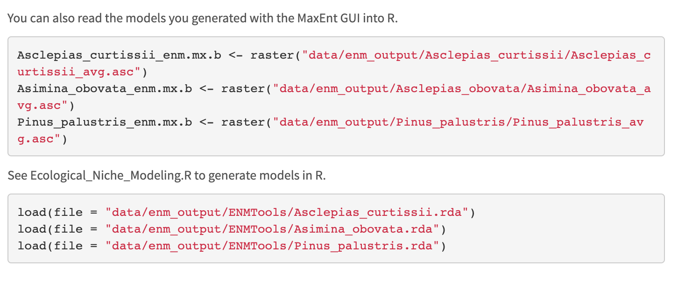
Load ENM Models

Slide 9
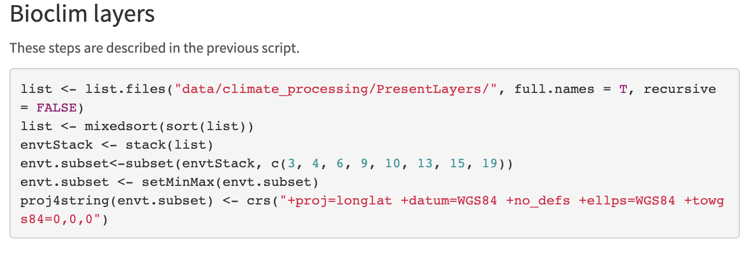
Load Bioclim layers

Slide 10
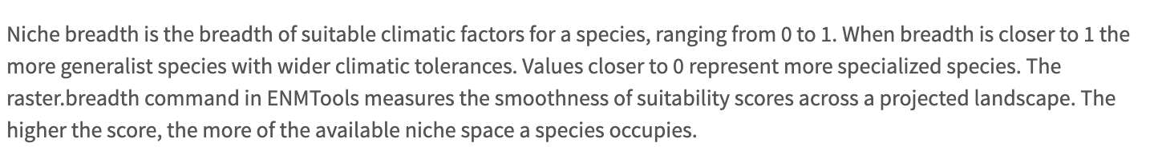
ENM Breadth

Slide 11
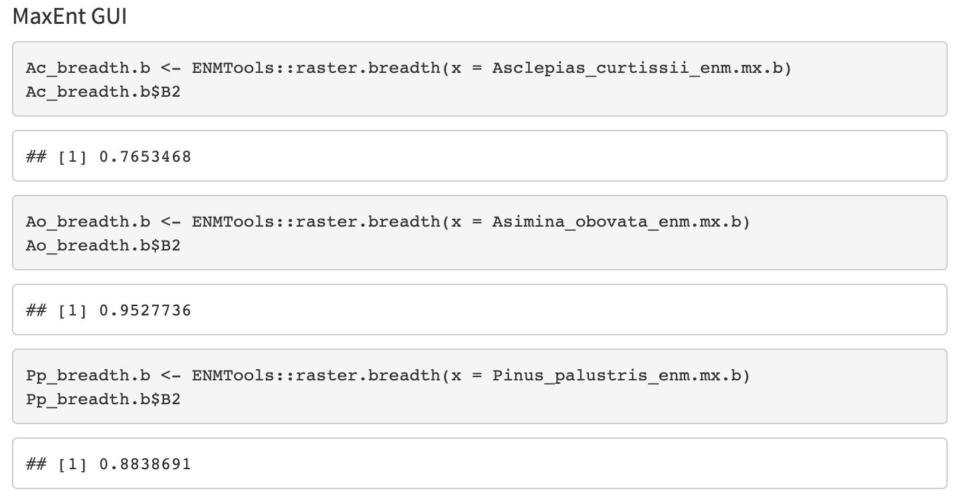
ENM Breadth

Slide 12
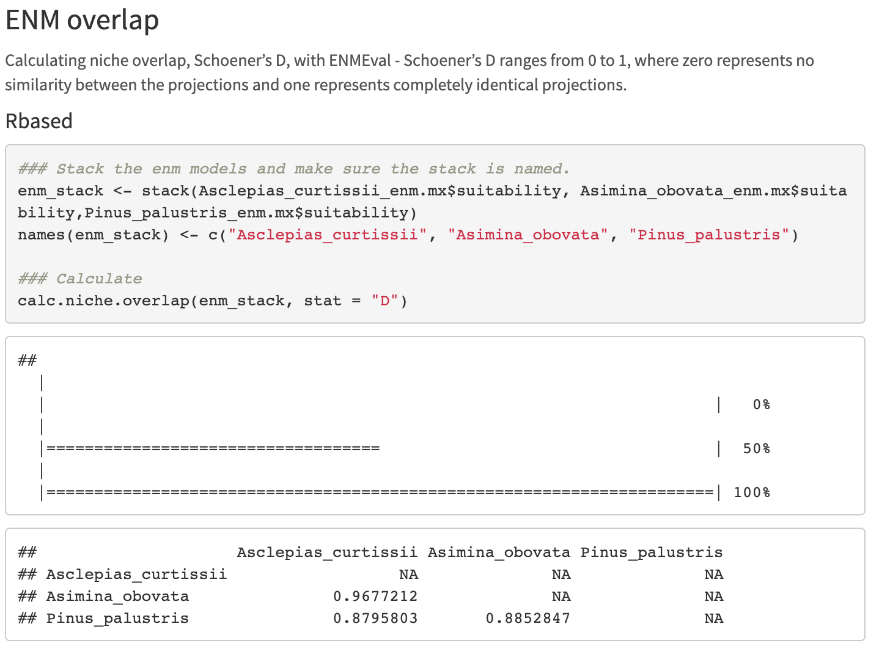
ENM Overlap

Slide 13
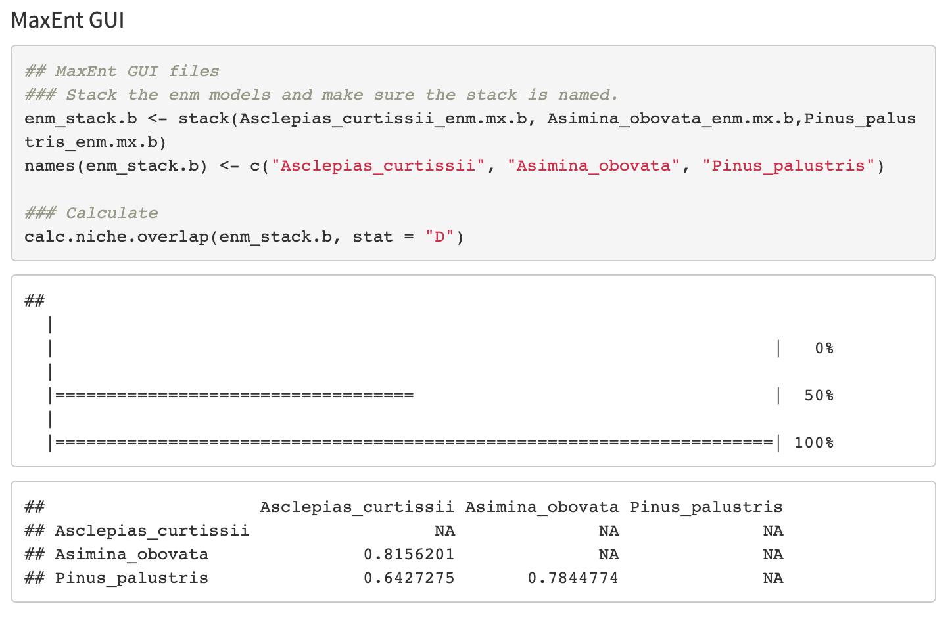
ENM Overlap

Slide 14
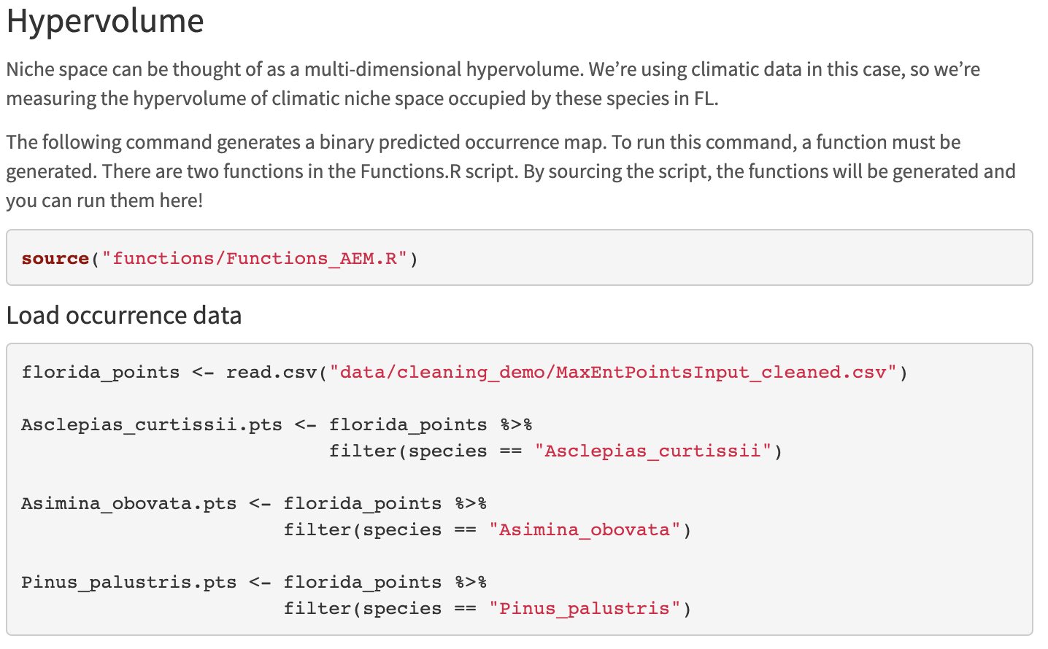
Hypervolume

Slide 15
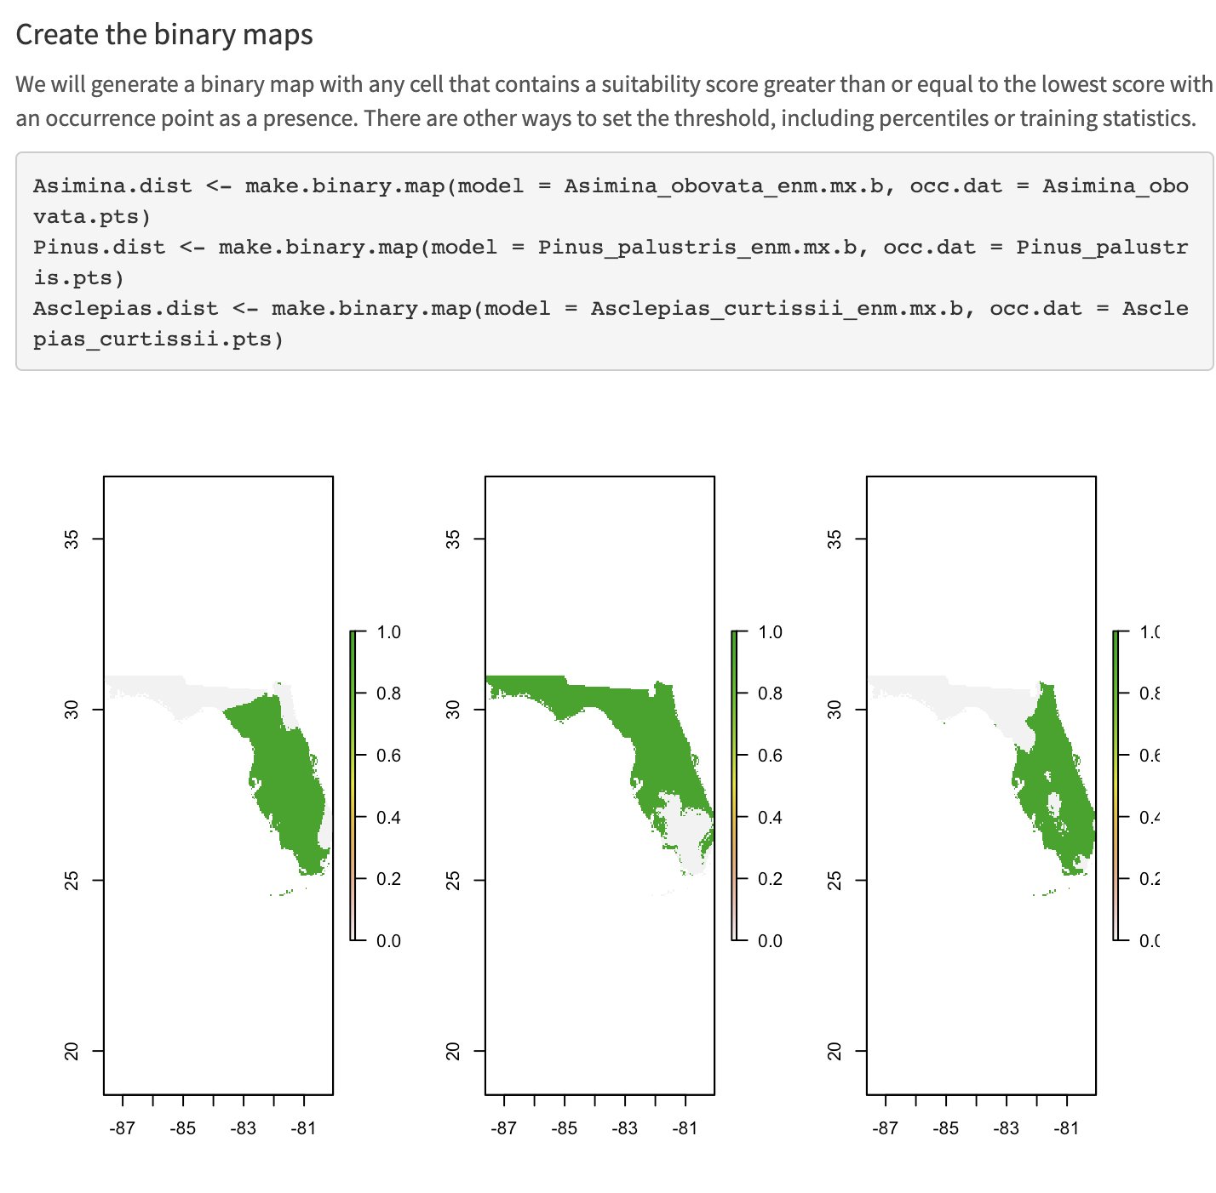
Hypervolume

Slide 16
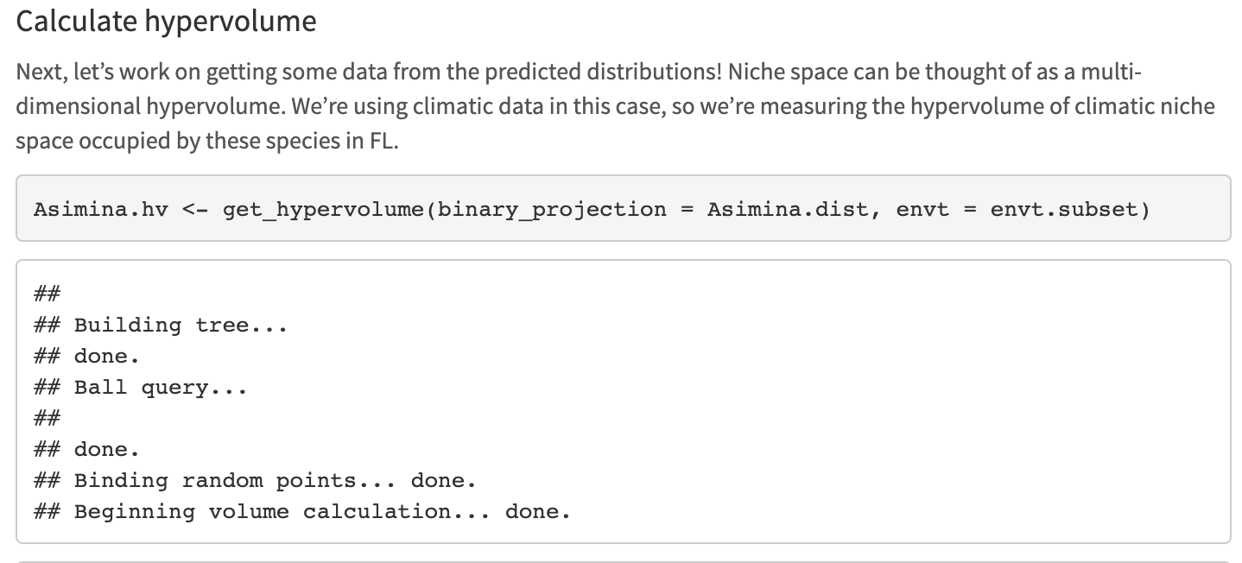
Hypervolume

Slide 17
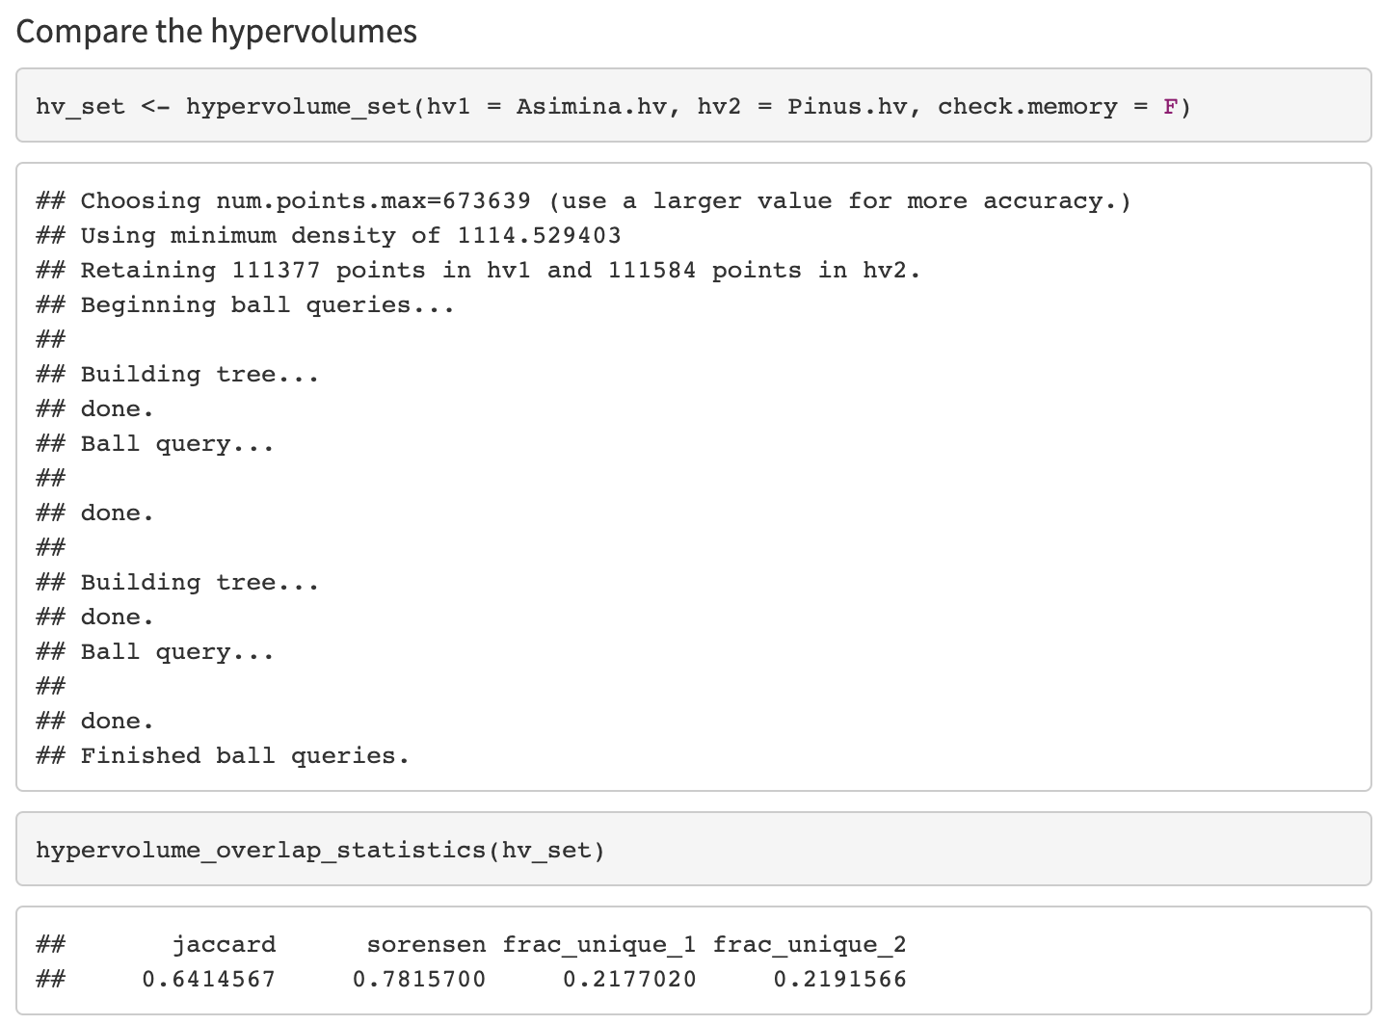
Hypervolume

Slide 18
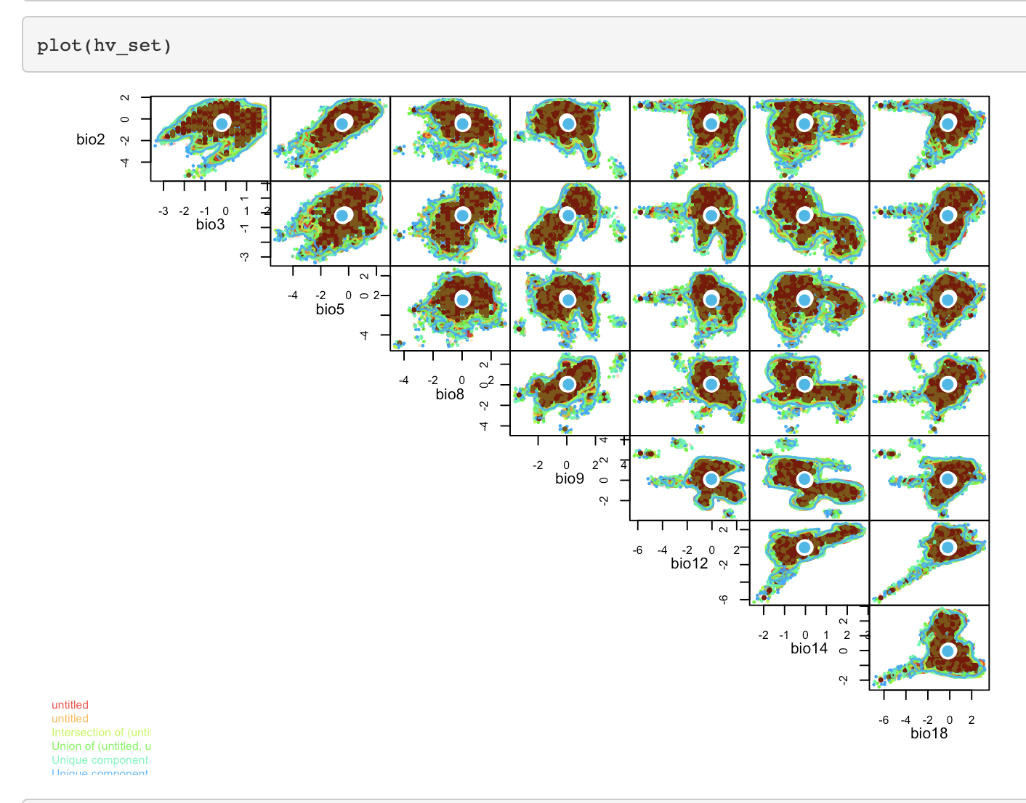
Hypervolume

Slide 19
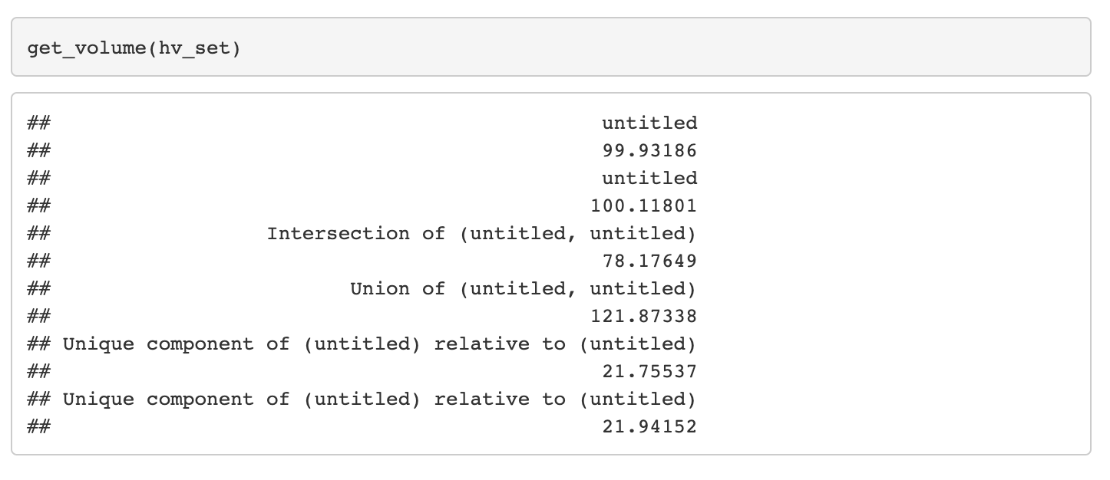
Hypervolume

Slide 20
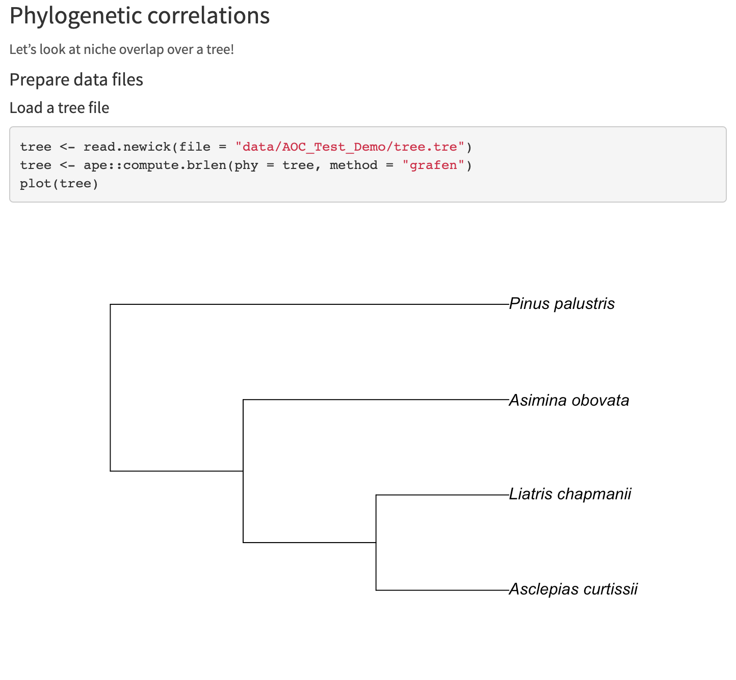
Phylogenetic correlation

Slide 21
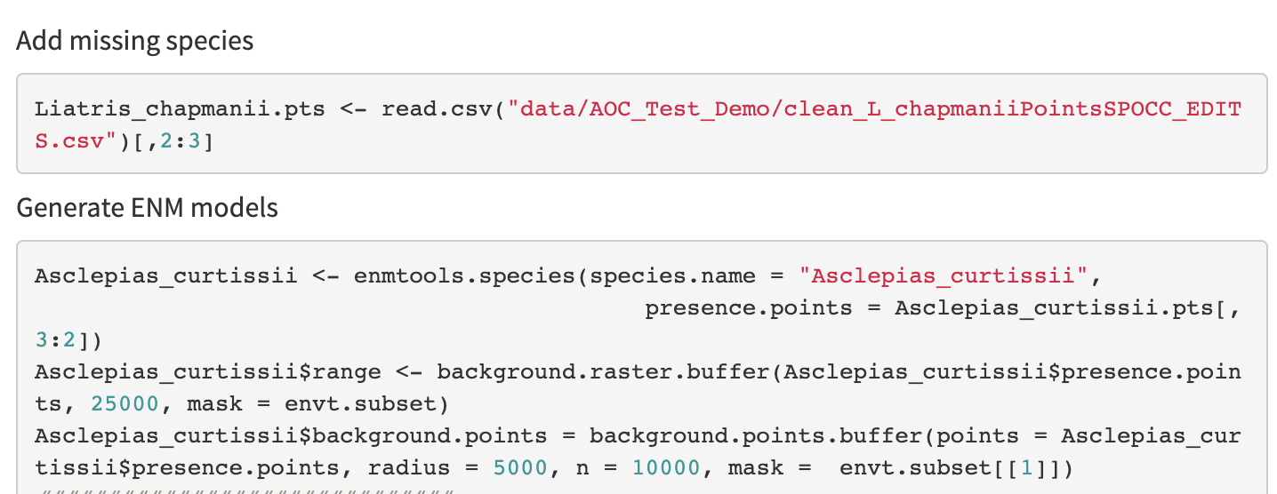
Phylogenetic correlation

Slide 22
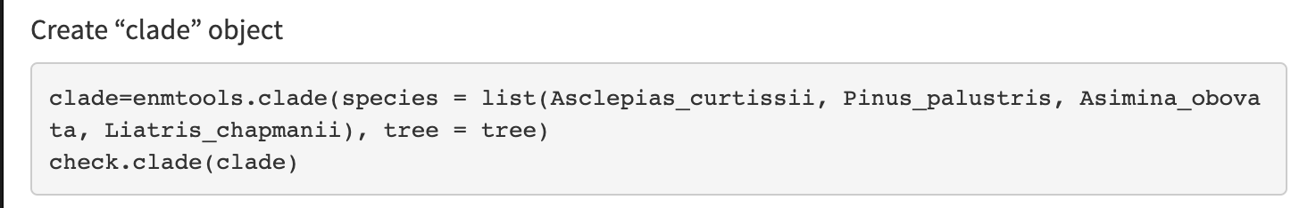
Phylogenetic correlation

Slide 23
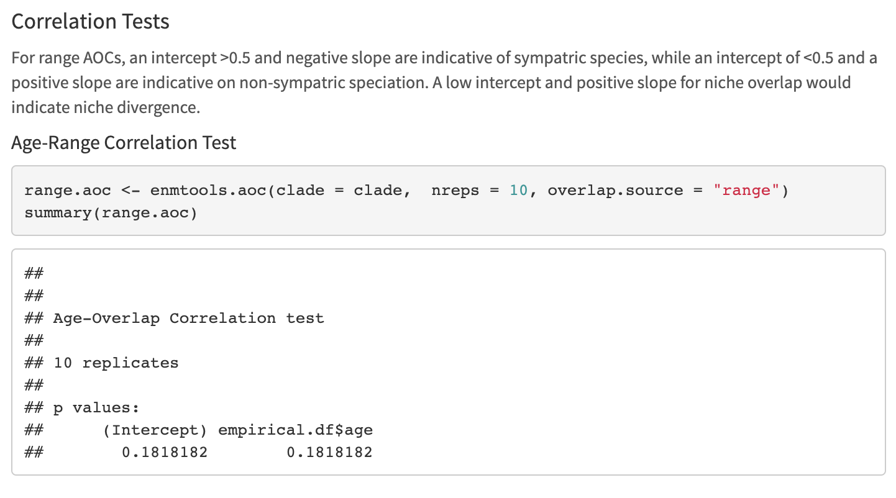
Phylogenetic correlation

Slide 24
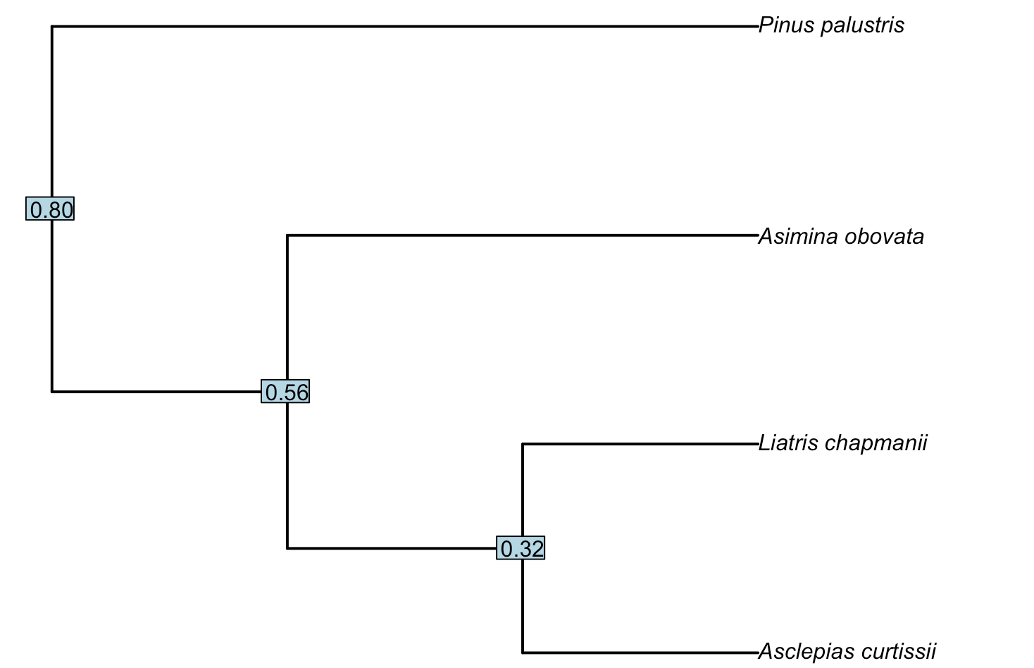
Phylogenetic correlation

Slide 25
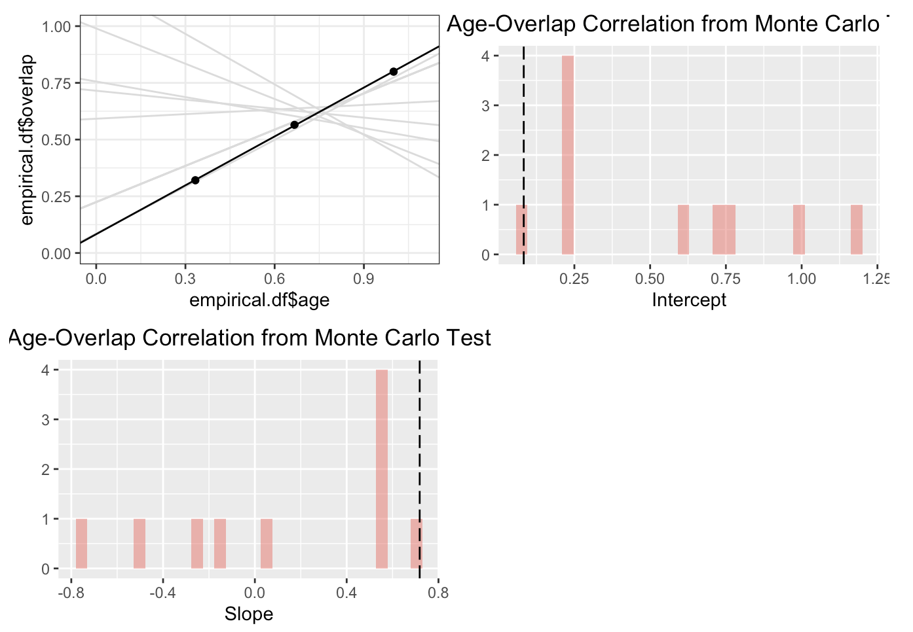
Phylogenetic correlation

Slide 26
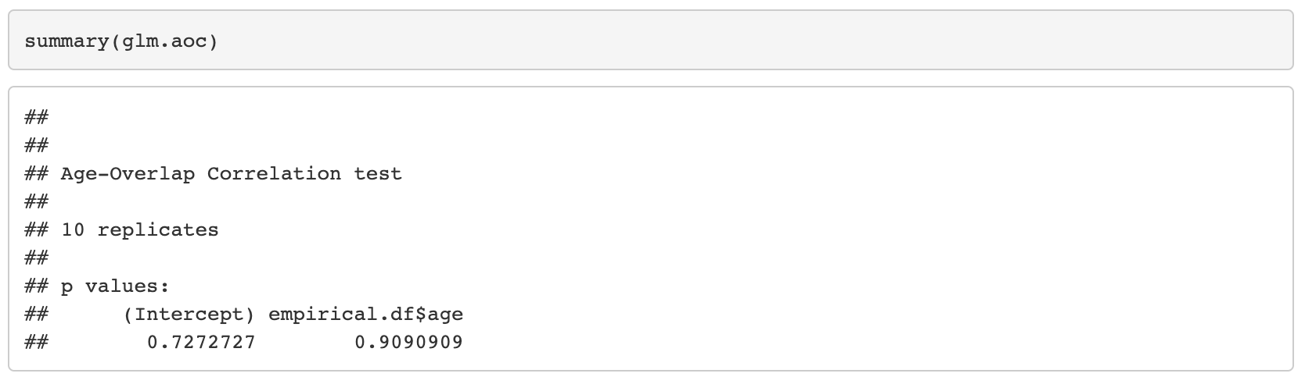
Phylogenetic correlation

Slide 27
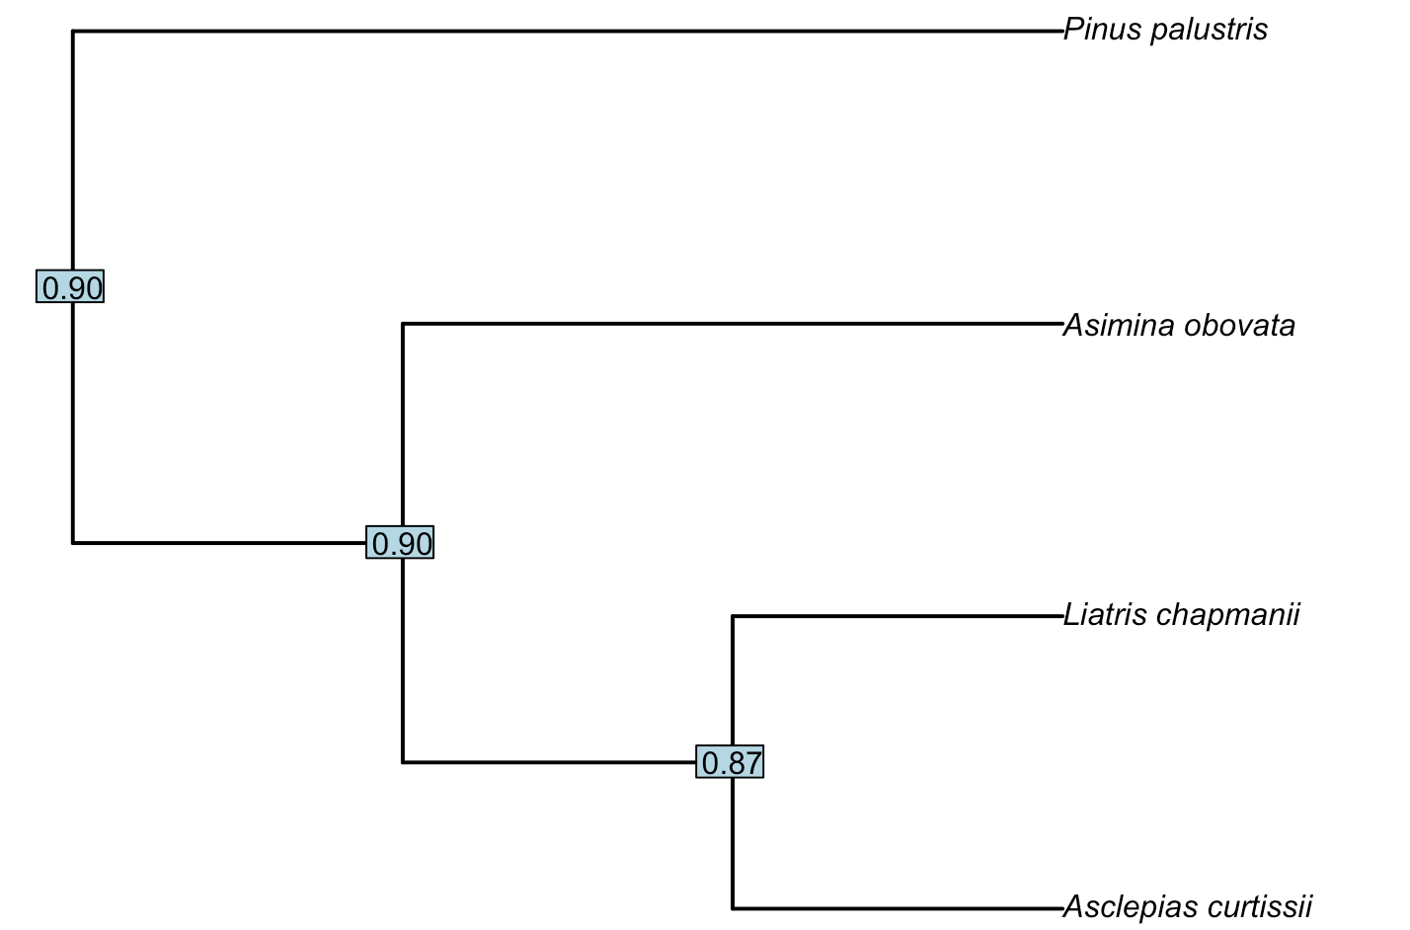
Phylogenetic correlation

Slide 28
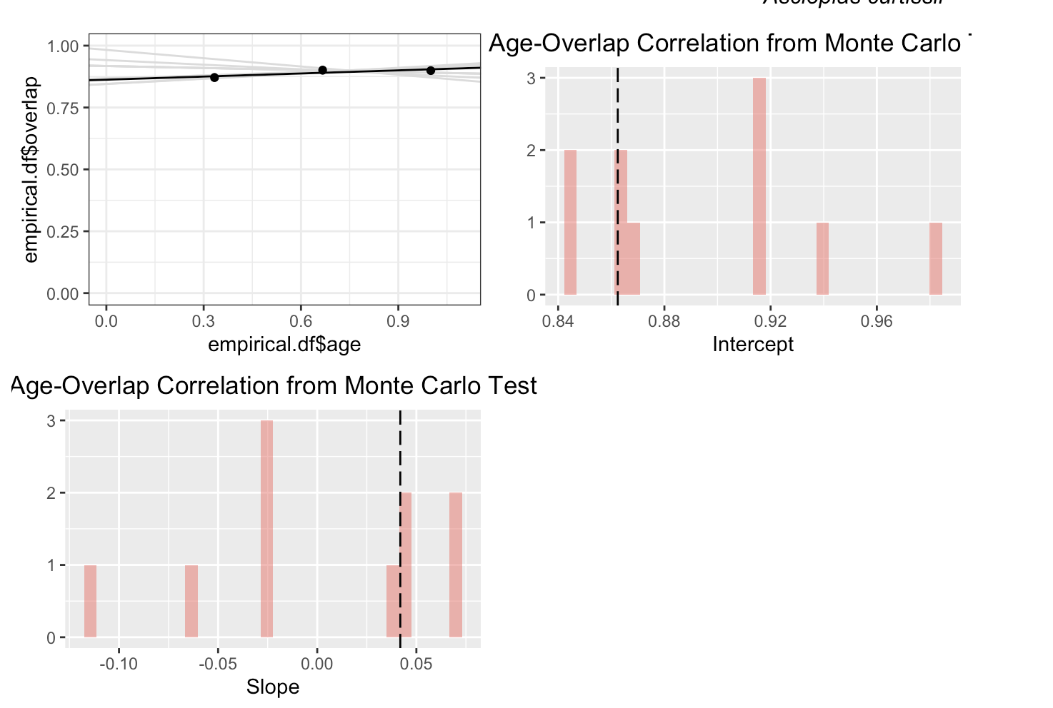
Phylogenetic correlation

